Slide 1
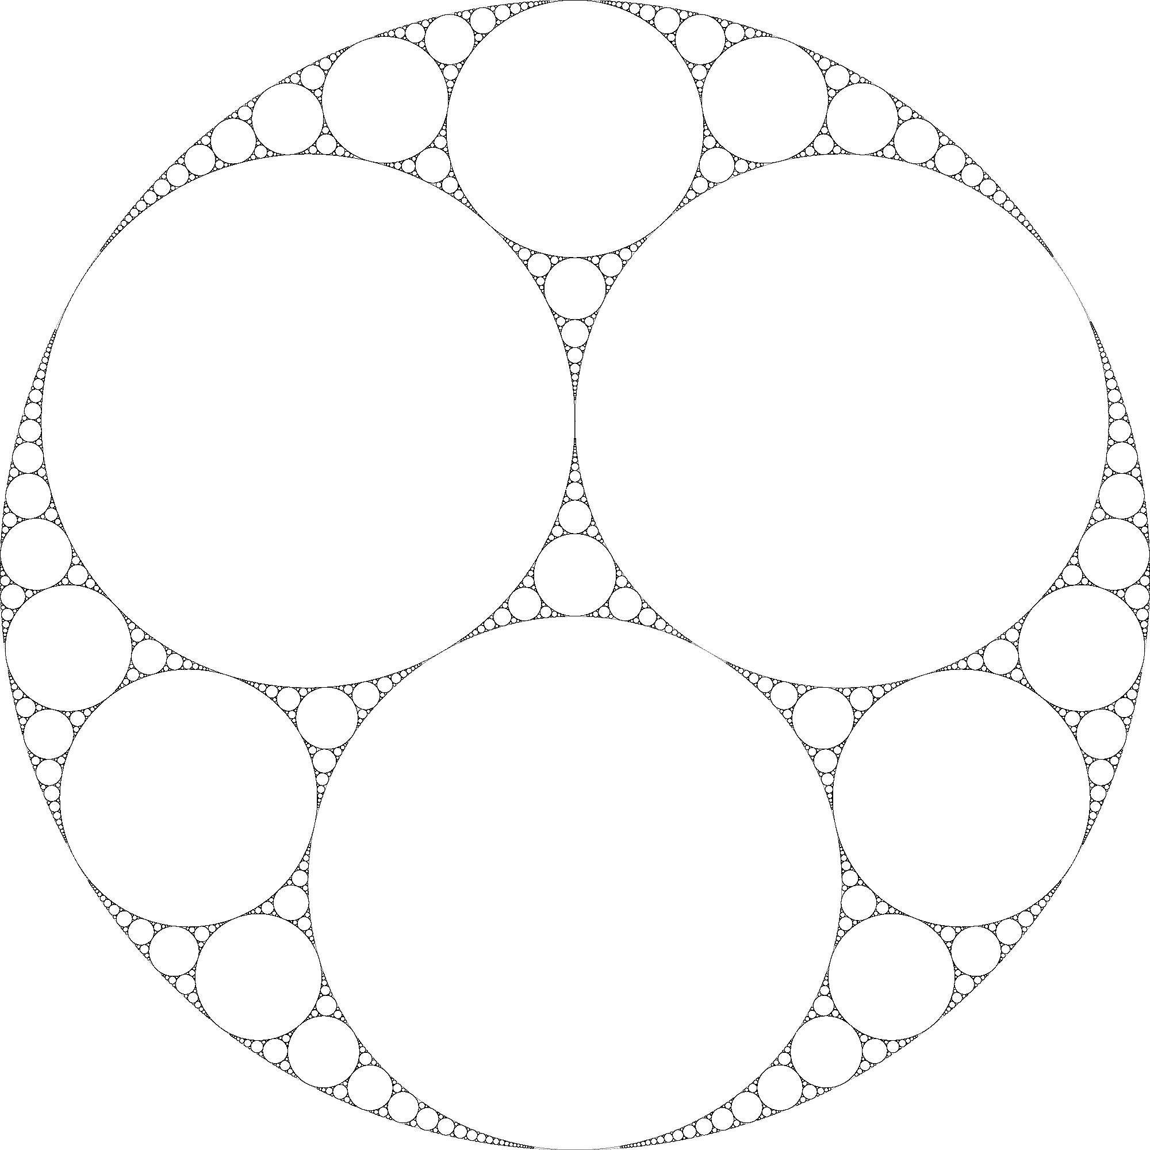
Jonathan M. Fraser Lecturer in Mathematics University of St Andrews jmf32@st-andrews.ac.uk
Pure mathematician working on fractal geometry.
PhD, University of St Andrews (2013).
Previous appointments at the Universities of Warwick and Manchester before returning to St Andrews in 2016.
Passionate about teaching, and making maths interesting and accessible.
Currently hold a Leverhulme Research Fellowship to investigate the Assouad dimension of fractals.

