Slide 1
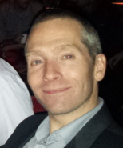

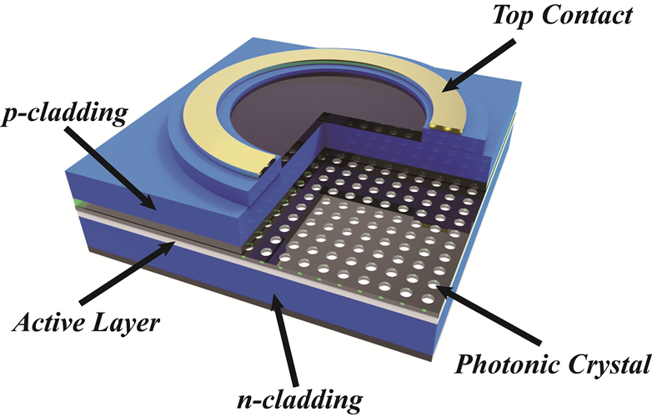
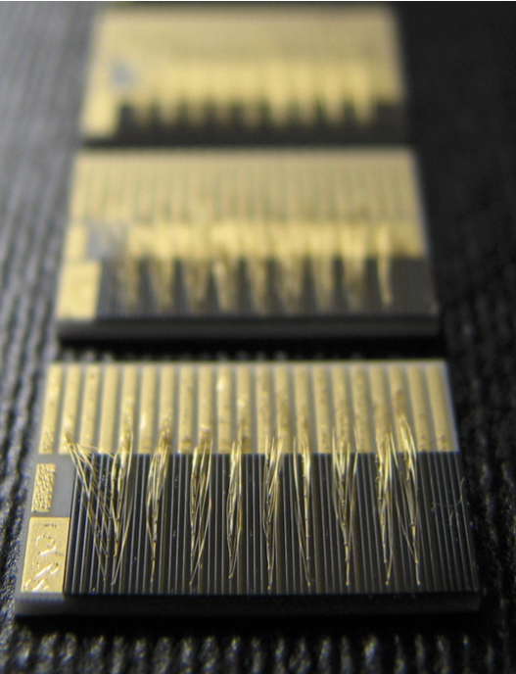
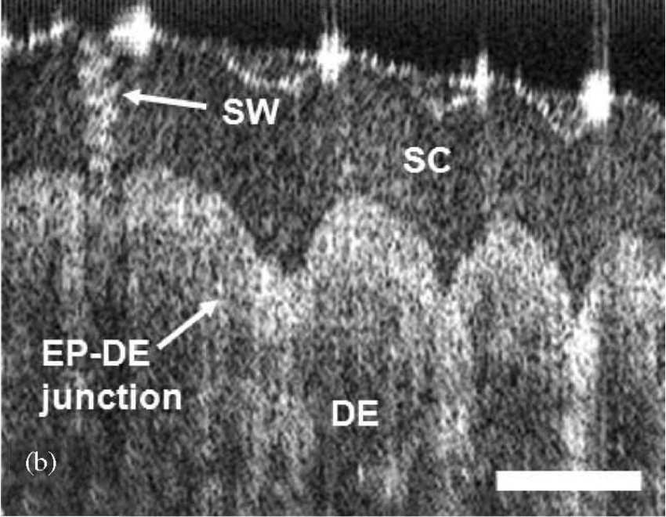



David Childs – Lecturer in Electronics and Nanoscale Integration
david.childs@glasgow.ac.uk
Photonic Devices for
Modulation speed, spectral bandwidth, power, efficiency, beam quality, tunability
Example Photonic Devices
LED, super-luminescent diodes, lasers…
Wavelengths
Blue/UV, visible, infrared, mid-infrared, THz…
My Background
Both academia and industry
Imperial College, London
Marconi Optical Components
University of Sheffield University of Glasgow
Optical Systems
High brightness lasers
Tuneable laser systems : near IR and mid-IR
Optical coherence tomography systems
Micro photoluminescence mapping
Selective laser sintering (3D printing)
Hyperspectral imaging
Photonic integration
Applications
Optical coherence tomography; skin imaging, dermatology, retinal imaging, corneal imaging
Biological fingerprinting; cancer detection, disease vector identification
Plastics identification
Oral cavity imaging…
Pretty much every application that is limited by the cost or performance of the light source can be better with semiconductors !
Collaboration
Do you use laser systems?
Are you limited by your wavelength, size, cost?
That’s where I can help…
500um

