Slide 1
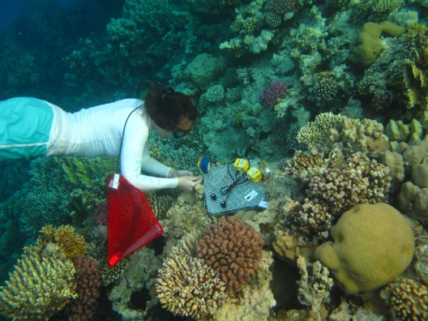
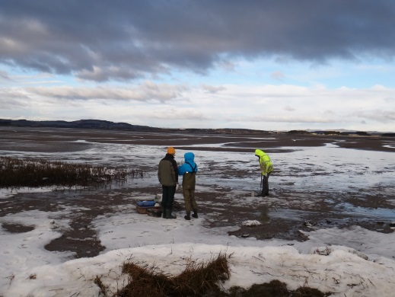
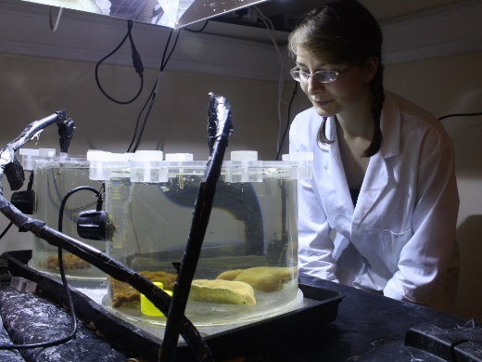
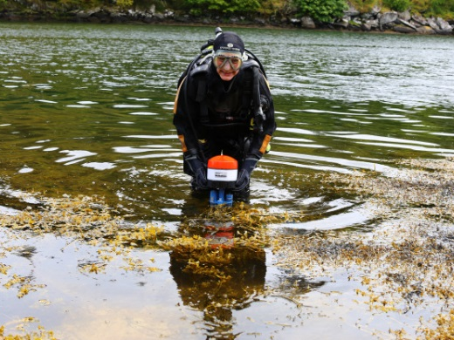
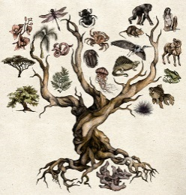
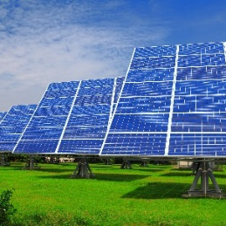
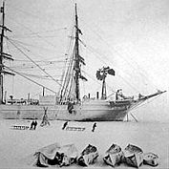
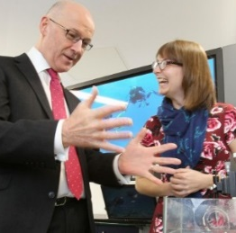
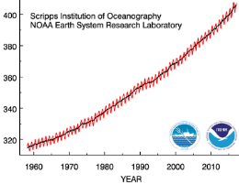
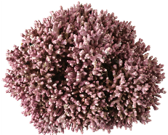
Heidi Burdett
How do photosynthetic organisms interact with their environment?
Fine scale
Bigger picture
CO₂
Cellular mechanisms: physical limits
Geochemical role: carbon storage
Impact of climate change: past and future
Evolution: emergence of photo-autotrophy
Biodiversity: maintenance of food security
Engineering applications:
Light harvesting
History: evolution of the sciences
Engagement: Public and policy
h.burdett@hw.ac.uk
@HLBurdett

