Slide 1
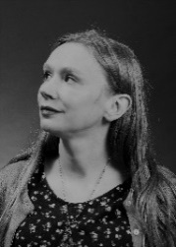
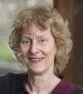
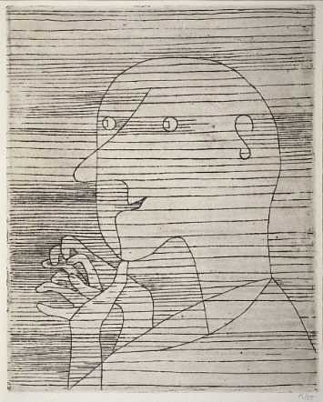
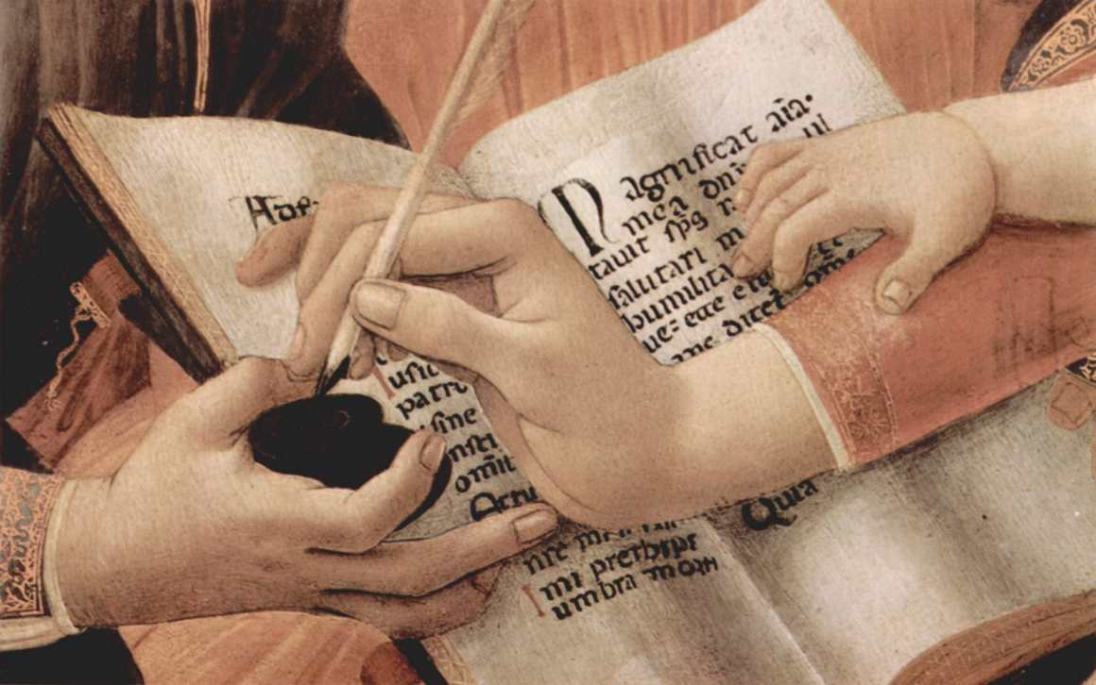
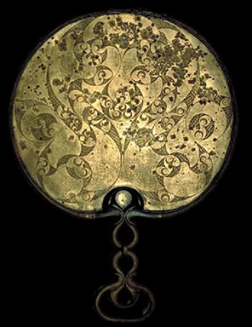
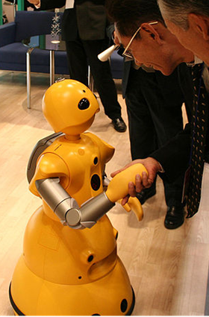
Miranda Anderson
University of Edinburgh
miranda.anderson@ed.ac.uk
A History of
Distributed Cognition
www.hdc.ed.ac.uk
Palimpsest Project www.litlong.org
Webpage
http://bit.ly/1A3Qajs

