Slide 1
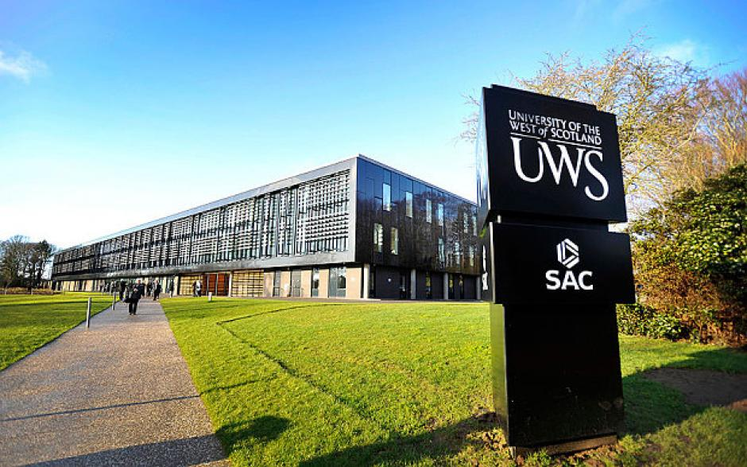
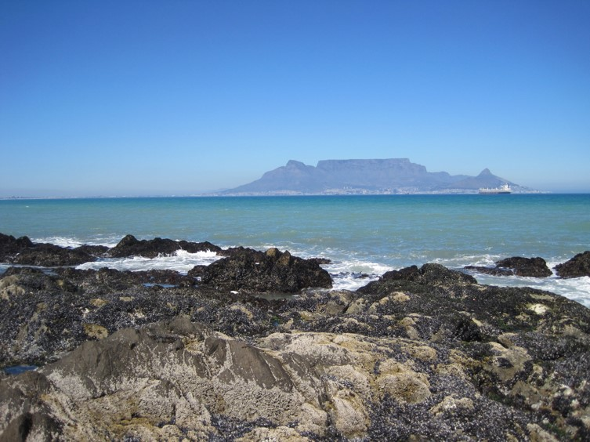
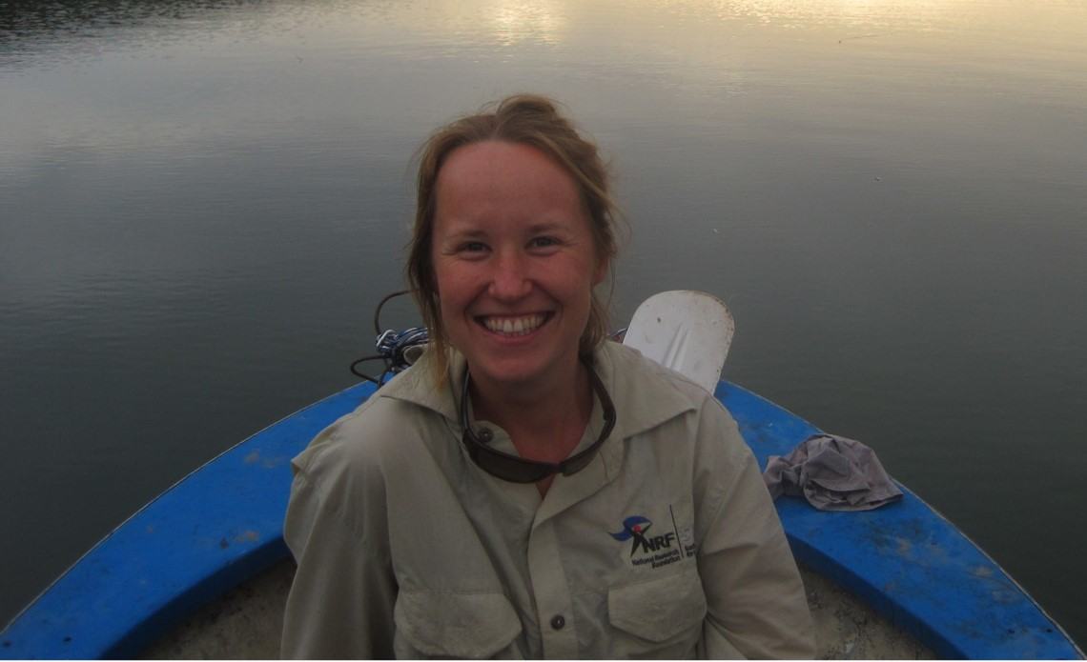
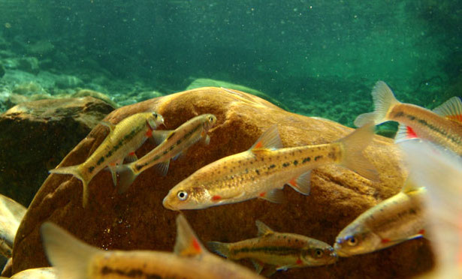
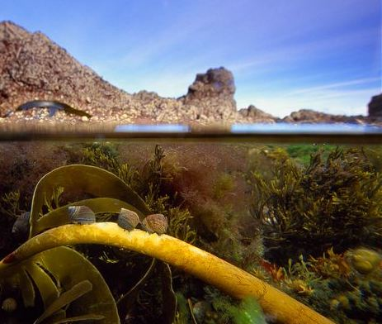
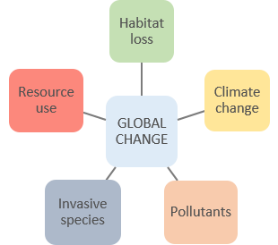
Who I am…
ecosystems
animal behaviour
interactions
biodiversity
populations
trophic
change
marine
species
My research career…
productivity
terrestrial
zoology
ecology
plants
analysis
relationships
theory
conservation
Environment
Economy
INVASION SCIENCE
The Scottish Crucible…
Dr Mhairi Alexander – mhairi.alexander@uws.ac.uk
University of the West of Scotland
Society
My research interests…

