Slide 1
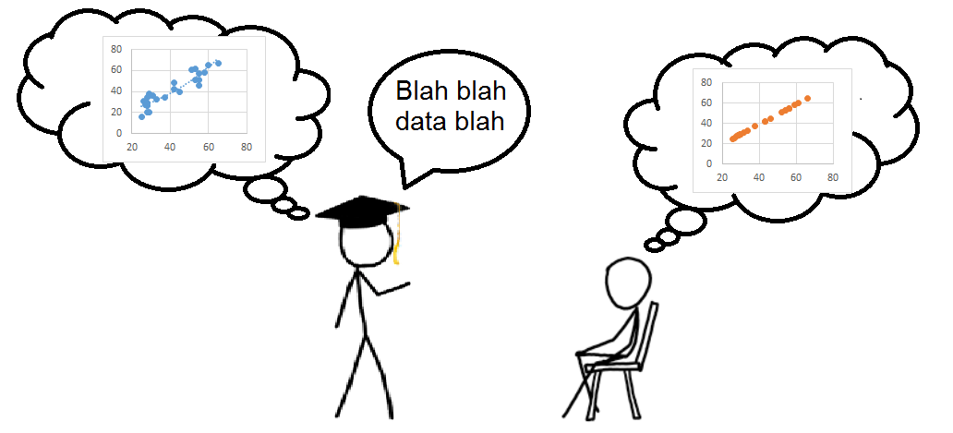
Chris Cummins
Choosing and understanding utterances in dialogue
…is part of linguistic pragmatics
(the study of meaning in use)
At the sentence level, need to understand how words (and other linguistic forms) relate to the meanings they are used to convey.
e.g. “most people” = “more than half”?
Does “more than 80%” mean just anything above 80%, or also convey “less than 90%”?
At the discourse level, need to understand how speakers decide precisely what they’re going to communicate during an interaction.
How do we plan our play? What are our goals? How do we develop a strategy for accomplishing them through language?
Relevant for our understanding of language and human interaction: also potentially important for the development of artificial dialogue systems and other agents.
Overarching research question:
In dialogue, how do we select what information to convey, how do we put it into words, and how do we recover that information from those words?
…is a possible confound in research on cognitive biases
Extensive research showing that participants draw seemingly irrational inferences.
e.g. 95% lean judged better than 5% fat
Base-rate neglect: John has long black hair and listens to death metal…is he more likely to be a Christian or a Satanist? etc.
However, possible communicative confounds. Do the descriptions actually have only their “literal” meanings, or do they get enriched?
Do we assume that the information provided is relevant for the question being asked?
Given these concerns, how robust is the evidence for cognitive biases? Or, which ones are still evidentially clear?
…has potential implications for health and risk communication
At least two possible levels at which this type of research could be relevant:
Presenting information in such a way as to convey its (quantitative) content accurately.
e.g. side effects are standardly described as ‘very common’, ‘common’, ‘uncommon’, etc., but these terms have context-dependent meanings and are widely misunderstood here.
Planning interactions in such a way as to elicit the most useful information.
e.g. framing questions in GP consultations so as to reduce patients’ unmet concerns; helping first responders obtain relevant information about emergencies from non-expert family members or bystanders;
improving the usability of automated services for self-diagnosis.
…relies upon cognitive psychology
(the study of mental processes)
Crucial to consider how we represent information in the mind, and how it is possible to transcode this into the form of language.
How are propositions represented? What does the language of thought look like? Is quantity information represented in probabilistic terms?
Reasoning is also essential, as we often speak indirectly, relying on hearers to fill in the gaps.
What inferences do we draw spontaneously? What costs are associated with them?
Language potentially provides a window into the mind, and exposes processes of interest. Psychological methods correspondingly offer us insights into linguistic questions.
I’m interested in pursuing these questions particularly with reference to expressions of quantity, such as numbers, quantifiers, percentages, etc.
Quantity expressions continue to be widely studied in linguistic pragmatics and cognitive psychology, and are used in classic research on cognitive biases: better understanding them would be beneficial to all these fields.
At the same time, expressions of quantity are essential to many of the most important things we talk about. They’re obviously relevant to health and risk communication, and I think there’s great potential for improving practice in these areas by refining and using linguistic insights.
Indeed, science communication in general relies upon the use of numerical expressions of quantity, which provide the kind of precision that is essential to the enterprise. But it’s not clear how well these expressions are understood by non-experts (or even sometimes by their expert users). I hope to explore whether a better understanding of the linguistics could yield better communicative results, for researchers and their audiences.
Scottish Crucible Forum, 4 September 2015

